Slide 1
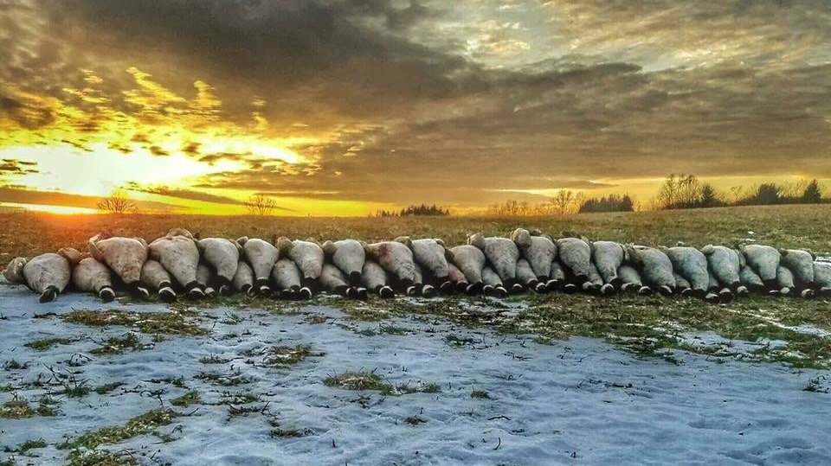

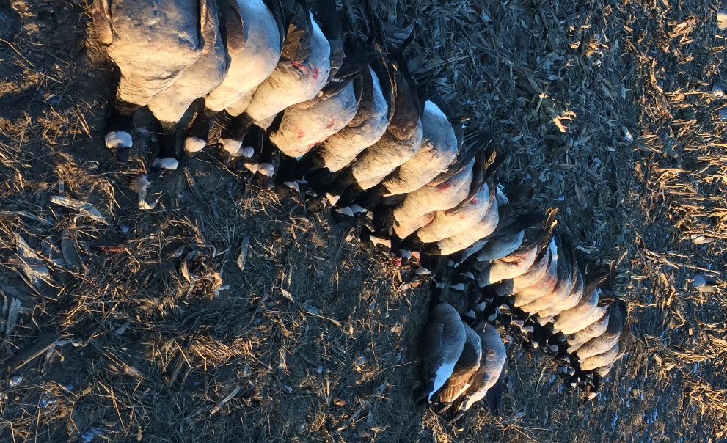
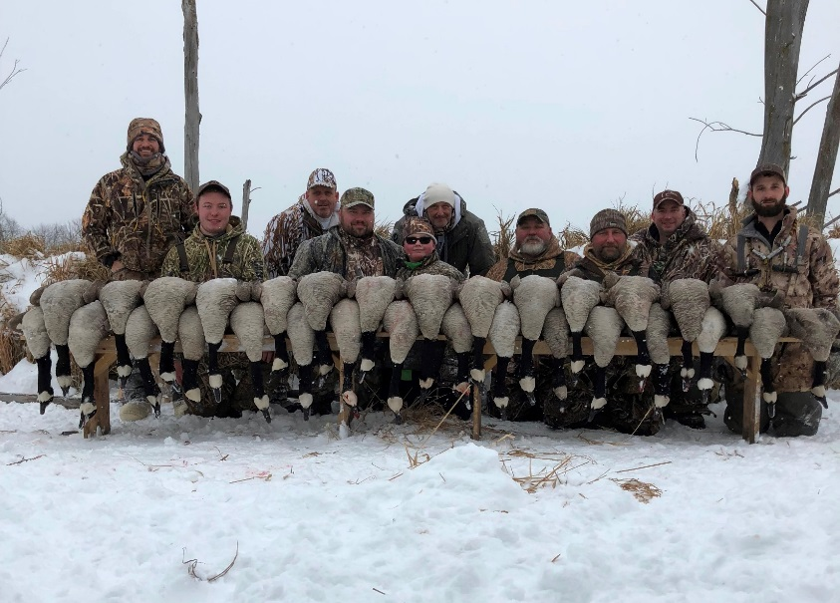
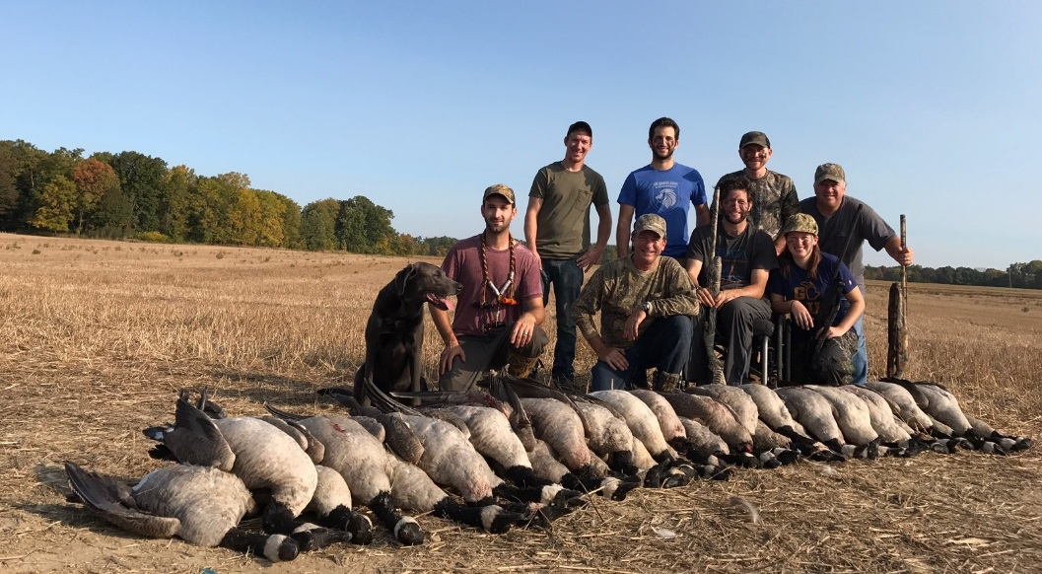
Sunrise Waterfowl Guided Hunt
Fully guided hunt for 5 hunters
Located in S.E. Michigan
Valid for 2018/2019 Season

Slide 2
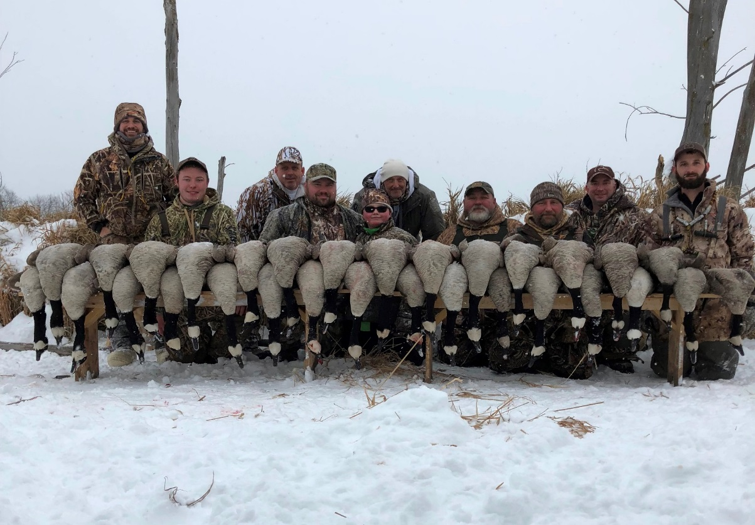
Sunrise Waterfowl Guided Hunt
Fully guided hunt for 5 hunters
Located in S.E. Michigan
Valid for 2018/2019 Season

